Slide 1
Measuring Density of Wood by Ultrasound
Ryan Richardson
CS520

Slide 2
Wood as a Material
Wood is one of the most common materials used throughout human’s history
It has shown value in construction, education, furniture, as a fuel, and much more
We came to value wood for its strength, flexibility, and ease
Eventually needed a way to quantify those properties

Slide 3
Properties of Wood
Ran into many complications when we began trying to compare wood harvested across locations
The same species of wood grown in two locations can be drastically different
White Oak grown in Texas is going to have significantly different properties to White Oak grown in Maine
These properties were so different, that we’ve been able to use the history of fossilized wood as a reliable way to study climate change through Earth’s history

Slide 4
Methods of Quantifying Properties
Eventually, we found a way to determine the density of an object
Acted as a measure by comparing the mass of an object to volume of space it occupies
Generally, denser wood was stronger, more flexible, but not always harder to work, so density became a standard way to measure its suitability
Density is easy to measure when we have an object of neat dimensions
Something small enough to weigh, and clean enough to easily calculate its volume

Slide 5
Density of Non-neat Objects
How do you measure the density of the wood contained in a tree that is standing, or a misshaped crown, or any non-standard object?
Consider that wood is not the same throughout a tree, and that there are cases where the density changes within a single tree are greater than the density changes across different species
How do we then measure the density of a tree at different points without killing the tree?
How do we apply that to wood we’ve harvested but don’t want to compromise?

Slide 6
Potential Options
For a long time we’ve had limited options, the primary method for things we couldn’t easily measure as to drill a core of the harvested tree and analyze pieces from various depths.
Eventually discovered we could use Electricity
Light (Radiography and X-Rays)
Sound (Ultrasound)
Hammers (Literally hitting a block with a hard object and seeing what happens)

Slide 7
What’s Suitable?
Electrical Measurements can lead to extensive surface decay and require destructive means to start measurements
Radiography is expensive and requires a lot of equipment, plus it can’t be used on larger objects easily
Hammers are fun, but only so accurate
Ultrasound is a happy medium, the limitations are well established, it’s relatively cheap, and doesn’t take much equipment

Slide 8
How do we measure?
We set up 1 or more ultrasonic transducer on the object we want to measure
We send an ultrasonic pulse through it in a short burst, but with a known distance between sensors
The best frequencies are about 300kHz to 1600kHz, anything too high and the signal doesn’t travel far enough. Too low and we get too much interference
We measure the time it takes for the pulse to travel between those two points
We get a speed value based on the time and distance traveled

Slide 9
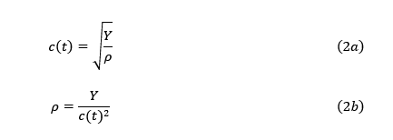
What About Density?
We know that the speed of sound is affected by many physical processes
Sound is a physical force itself, and so we can expect physical changes to impact the speed of sound
Sound travels faster through solid objects, with its speed increasing in proportion to the density of the object.
However, sound being a physical force is also impacted by the reaction of the object to other physical forces.
Measured by Young’s Modulus of Elasticity

Slide 10



Measuring Young’s Modulus
Introduce a stress/force across a given area
Measure the stress imparted by the force, based on the change in size based on the original size of the object
Young’s Modulus is equal to a ratio of stress relative to strain

Slide 11
It Can’t Be That Easy
It’s not.
Wood is not a normal material, the way it reacts to stress is dependent on the direction the stress is applied
This is called anisotropy, making wood an anisotropic material
Specifically, Wood is known as an orthotropic material
Essentially meaning that a force applied in one direction will behave symmetrical to the same force applied in the exact opposite direction, if the grain alignment is the same

Slide 12
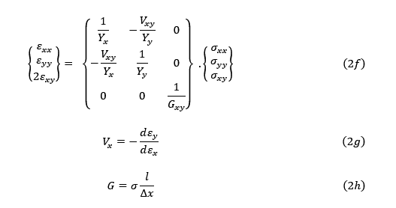
What? How Do we Do?
Some very smart people studied Differential Geometry and discovered how
These are combined into something called Hooke’s Laws
They establish a relationship between Young’s Modulus, something called the Shear Modulus, and Poisson’s Ratio
These are all very similar values, measuring a reaction to a force in a given direction
These are then distilled into a simplified matrix we can feed into our original equations

Slide 13
Putting It Together
Utilizing Hooke’s Law we take the sound-pressure exerted by our ultrasonic transducer (about 10dB at most), take note of the direction, and send it through Hooke’s Laws
Doing this right we can actually use the Shear Modulus as our primary measurement that cancels out the impact of Young’s Modulus and the Poisson Ratio for a small area of our object
We then take many measurements of the object, getting a single measurement for multiple slices of the area
Think of something like a CT scan that we now need to assemble

Slide 14
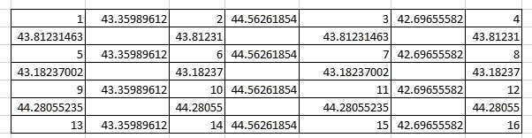
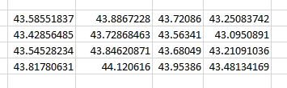
Putting it Together, More
I chose to take the polygons created by the areas between my slices as my target
I created an average density value for that polygon based on the density values of the vectors bounding the space
This produced a matrix of values of average densities across the measured areas

Slide 15
One More Round
In an effort to try any create a continuous measurement across the entire measured object, we can run our matrix through some forms of interpolation
For this project, nearest neighbor interpolation was the easiest to make fit for the data
Future iterations can easily be improved by taking many more slices of the object, taking slices tangential and normal to original providing a 3-d area for analysis
This would up the accuracy of the interpolation a bit, and give way to many more types of interpolation that would likely be a better fit for this data

Slide 16
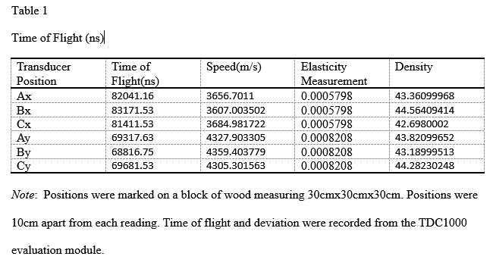
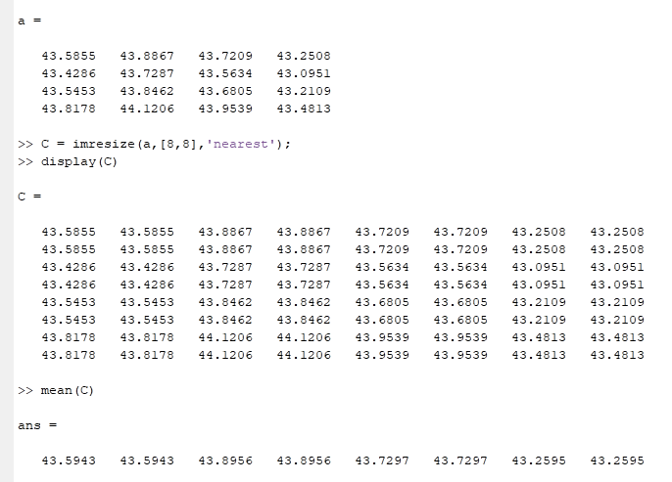
Some Results

Slide 17
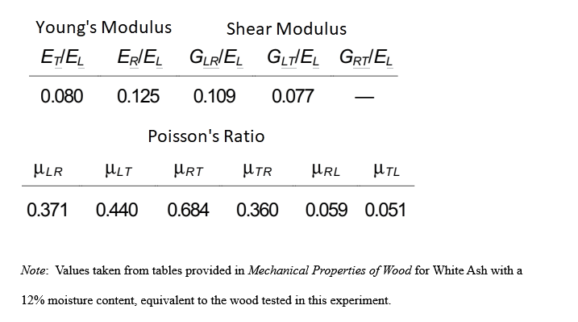
Modulus Values for Wood Sample (White Ash)

